Slide 1
Empowering Efficient Query Perf: Unveiling SQL Server 2022
Deepthi Goguri

Slide 2

Deepthi Goguri
Database Administrator
Data Platform MVP
Masters in Computer Technology
Co-Organizer for Data and AI South Florida User Group, DEI User Group, Data TGIF
Volunteer for Women in Technology User Group
Loves Plants, Arts and Crafts
Twitter: @dbanuggets
https://dbanuggets.com/
https://www.linkedin.com/in/deepthigoguri/

Slide 3
Agenda
Query Store hints
Parameter sensitive plan optimization
Memory grant feedback
Degree of parallelism (DOP) feedback
Cardinality estimation feedback

Slide 4
How Query Store Works?

Slide 5
Query
Are you running for the first time?
YES
NO
Compilation and Optimization
Plan in Cache?
NO
YES
Is this plan the same forced plan?
But wait, check for recompilation!
Alright, then take it from the plan cache!
CHECK
Oops, NO!
YES
1. Async
Query Text
Query Plan
Async
Plan Store
Query Store
Schema
Apply the forced plan
2. Run
In-Memory
Async
Query Executes
Async
Run time Stats
Runtime stats Store

Slide 6
Plan cache vs Query Store
Plan cache
Flushed out on every server restart
Stores latest plans
Evicted on memory pressure
Difficult to know why plan changed
Query Store
Retains the data (CLEANUP_POLICY)
Collects plans over time
Flush out intervals
Useful when troubleshooting performance problems

Slide 7
Query Store Advancements
Enabled by Default
Doesn’t change defaults with the migrated databases
Internal memory limits for Ad-hoc workloads
Query Store hints

Slide 8
Intelligent Query Processing

Slide 9
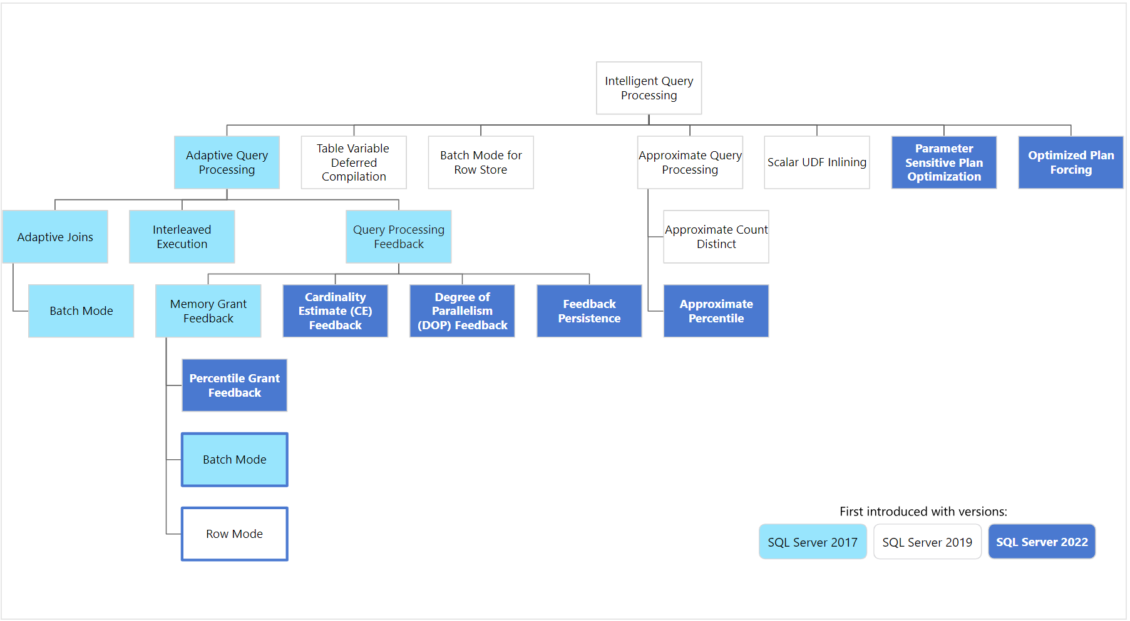

Slide 10
Highlights
No code changes – Works with latest Compatibility level
They work together (can have multiple features supporting query)
Large positive impact in performance

Slide 11
SQL Server 2022 – QS Advancements
Enabled by Default
Query Store data capture in secondary replica (preview)
Query Store hints
Parameter sensitive plan optimization
Memory grant feedback
Degree of parallelism (DOP) feedback
Cardinality estimation feedback
Optimized plan forcing

Slide 12
Parameter Sensitive Plan Optimization

Slide 13
Parameter Sensitive Plan Optimization
Also known as PSP optimization
Doesn’t depend on the QS
Dispatcher and Variant plans
Variant plans – plans based on wide range of the data rows returned

Slide 14
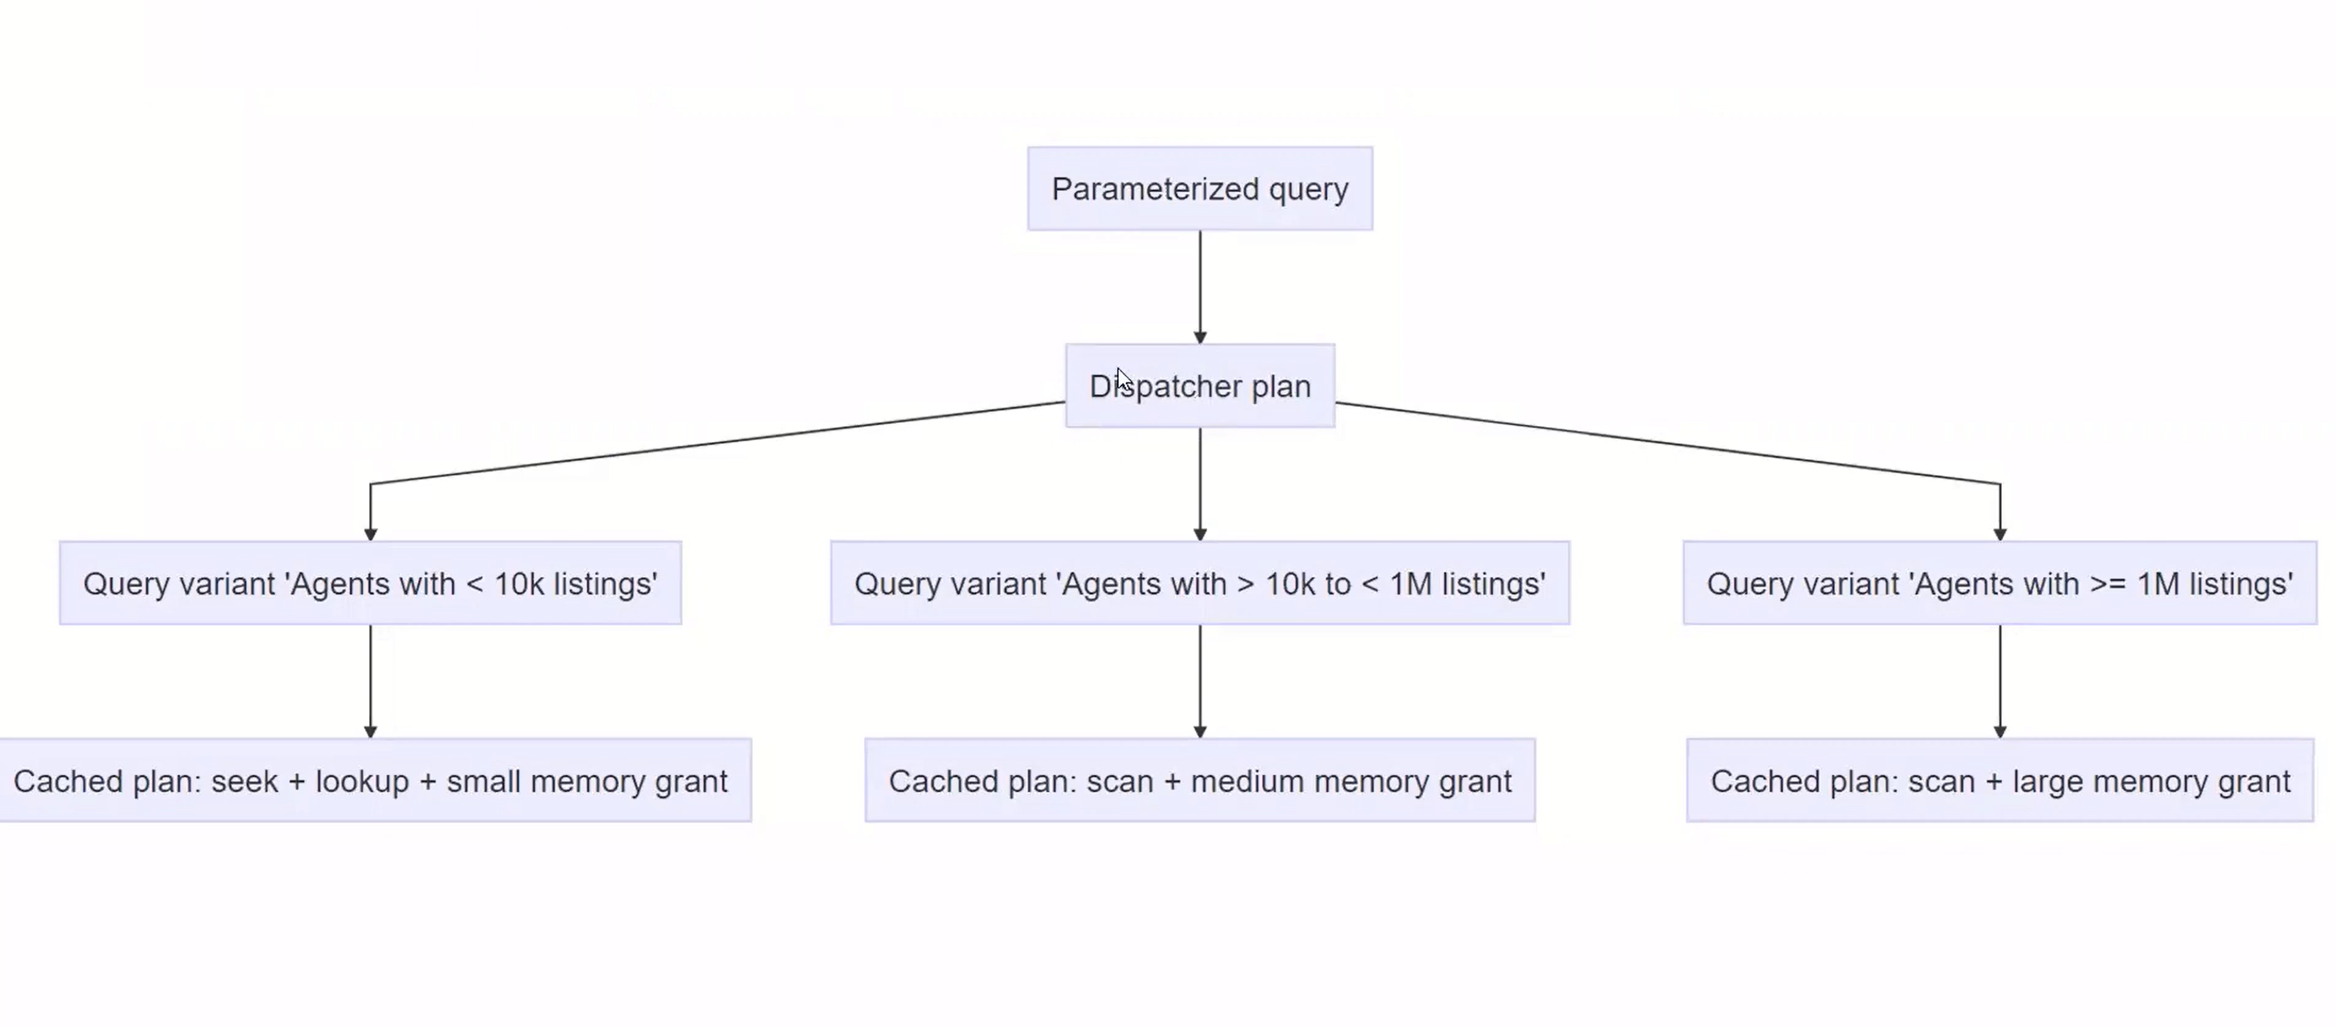
https://www.youtube.com/watch?v=BbaC6-2qsjI&ab_channel=MicrosoftDeveloper

Slide 15
Memory Grant Feedback Persistence and percentile

Slide 16
How a Query is Executed?
Query Optimization
Query
Transformation
Cardinality
Estimation
Costing
Plan Cache
Query Execution
Query
Plan Cache
Memory Grant
Query Execution

Slide 17
Memory Grant Feedback
Based on cardinality estimation – query taking more memory or less memory
Goal – remove spills and increase the concurrency workloads
SQL Server 2017 – Batch mode
SQL Server 2019 – Row mode

Slide 18
Improvements
Persistence
Doesn’t persist upon failover before SQL Server 2022
Saved Adjust memory information is lost
In SQL Server 2022, persist in the Query Store

Slide 19
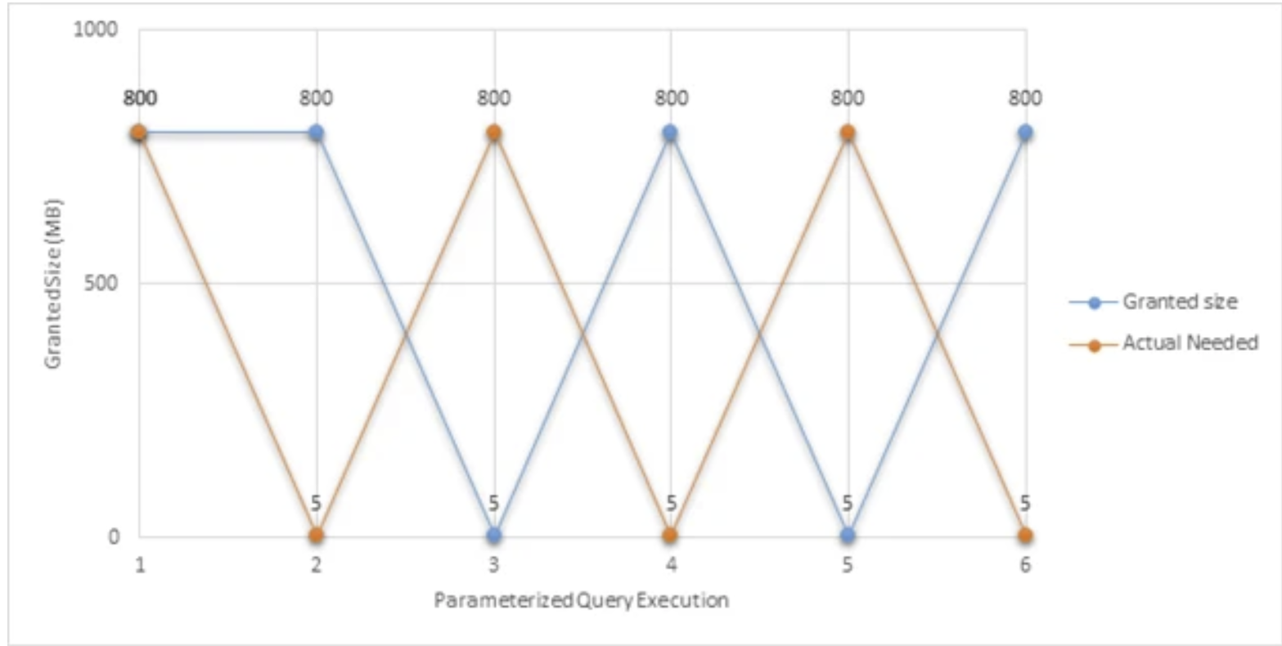
Memory Grant feedback before 2022
Single last execution info
Highly volatile queries
https://cloudblogs.microsoft.com/sqlserver/2022/10/27/memory-grant-feedback-persistence-and-percentile-grant/

Slide 20
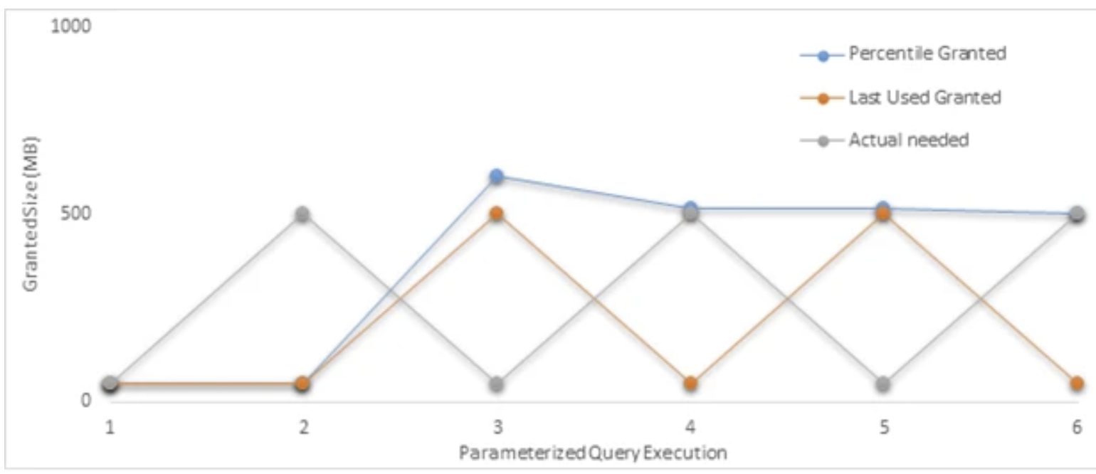
Memory Grant Feedback Persentile
Look at the history of the executions
Avoids spilling to disk with good memory grants
Persist on Failovers, restarts and plan evictions

Slide 21
Cardinality Estimation Feedback

Slide 22
Cardinality Estimation Feedback
Estimates on the number of rows
Depends on the data distribution
Memory, CPU and joins
Model related assumptions based on history
Uses 3 CE techniques
Predicate Independence vs Correlation
Containment
Row goal
Identify-verify-replace and persist through the query hinting method in QS

Slide 23
CE feedback
Compat 160
Repeating queries with persistent plans
Verified only feedback is implemented
Use the Query store hints

Slide 24
DOP Feedback

Slide 25
DOP Feedback
Where parallelism is not effective by checking CPU, elapsed times and waits
Uses the QS data
Sys.Query_store_plan_feedbacks
Automatic MAXDOP settings on the query and evaluate
Persisted on the plan cache flush
Is the query eligible? If yes gets feedback provided> validation and stabilized

Slide 26
References
Azure SQL & SQL Server 2022: Intelligent Database Futures
Intelligent query processing in SQL databases

Slide 27
Thank you!

